Slide 1

Cloud Computing
Capstone Project
C. Venkata Kamali
[192211325]

Slide 2
Online Blood Banking System…

Slide 3

Abstract……
The Online Blood Banking System is a comprehensive platform designed to streamline and enhance the blood donation process using cloud technology. Implemented on an open cloud platform, such as AWS, Azure, or Google Cloud, this system facilitates the seamless connection between blood donors, recipients, and blood banks. The platform includes modules for donor registration, blood donation scheduling, inventory management, and recipient matching. Donors can easily sign up, view nearby donation drives, and schedule appointments. Blood banks can efficiently manage their inventory, track blood supply levels, and ensure the safe and timely distribution of blood to recipients. The system also features an intelligent matching algorithm to connect recipients with compatible blood donors quickly. By leveraging the scalability, reliability, and security of cloud infrastructure, the Online Blood Banking System aims to improve the efficiency of blood donation processes, enhance accessibility for donors and recipients, and ultimately contribute to saving more lives.

Slide 4
Introduction:
An online blood banking system leverages digital technology to streamline and enhance the process of blood donation, storage, and distribution, ensuring efficient management of blood resources.
This system provides a platform for potential donors and recipients to access information and services from anywhere, making it easier to find and donate blood, and to request and receive needed blood products.
With real-time updates, users can quickly learn about the availability of different blood types, upcoming blood drives, and urgent needs for specific blood groups, facilitating timely donations and distribution.
The system offers improved communication channels between blood banks, hospitals, and donors, allowing for better coordination and faster response times during emergencies.
It ensures secure and efficient handling of sensitive data related to donors and recipients, including medical histories, blood types, and donation records, while complying with privacy regulations.
An online platform can be used to raise awareness about the importance of blood donation, engage with the community through educational content, and encourage more people to become regular donors.

Slide 5
Existing System:
Cloud Infrastructure Setup:
- Choose a cloud platform (e.g., AWS, Azure, Google Cloud).
- Set up a cloud account and configure the necessary services, such as virtual machines, databases, and storage solutions.
Database Design:
- Design a relational database schema to store information about donors, donations, blood types, inventory, and requests.
- Use cloud database services like Amazon RDS, Azure SQL Database, or Google Cloud SQL.
Backend Development:
- Develop the backend using a server-side language (e.g., Python, Java, Node.js).
- Implement RESTful APIs for interacting with the frontend and mobile applications.

Slide 6
Proposed System:
The Online Blood Banking System will be designed and implemented on a robust open cloud platform, such as AWS, Google Cloud, or Microsoft Azure. The proposed system will consist of several modules, including user registration, blood inventory management, donor management, recipient management, and reporting and analytics.
Donor Management: This module will allow donors to register their profiles, including their blood type, donation history, and eligibility status. It will also send reminders to eligible donors for upcoming donation camps or when their blood type is in demand.
Blood Inventory Management: Blood banks will be able to manage their inventory of blood and blood products, including tracking the storage conditions, expiry dates, and current stock levels. This module will use real-time updates to ensure accurate and up-to-date information.
Recipient Management: Hospitals and medical professionals can register as recipients to request specific blood types. This module will match requests with available stock in nearby blood banks and notify the relevant blood bank for fulfillment

Slide 7
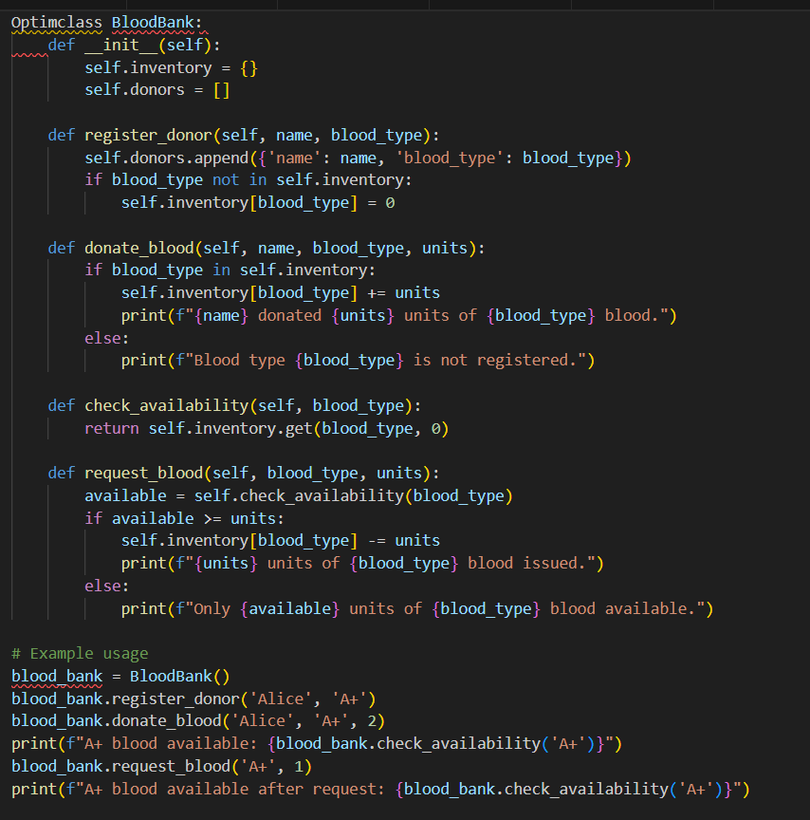
Implementation……

Slide 8
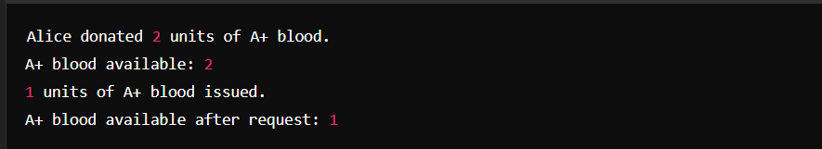
Output:

Slide 9
Future Scope:
AI and Machine Learning Integration:
-Implement AI algorithms to predict blood demand based on historical data and trends.
-Use machine learning for donor matching and personalized communication.
Blockchain for Transparency:
-Utilize blockchain technology to ensure transparent and tamper-proof records of blood donations and distributions.
-Enhance trust among donors and recipients through verifiable and secure transactions.
Mobile App Development:
-Develop user-friendly mobile applications for easy access to services, notifications, and real-time updates.
-Incorporate features like location-based donor recruitment and nearby donation camp alerts.

Slide 10
Conclusion…..
Implementation of an Online Blood Banking System on an open cloud platform significantly enhances the efficiency and accessibility of blood donation and transfusion services. By leveraging cloud technologies, the system ensures robust scalability, security, and reliability, allowing healthcare providers and donors to interact seamlessly and in real-time. This platform facilitates the real-time updating of blood inventory, streamlines the donor registration and scheduling processes, and ensures the availability of critical information during emergencies. Additionally, cloud integration offers advanced data analytics capabilities, enabling better decision-making and strategic planning for blood supply management. Overall, the system not only improves operational efficiency but also plays a crucial role in saving lives by ensuring timely and adequate availability of blood resources

Slide 11


